Slide 1
National Institute of Technology Calicut Dept. of Computer Science and Engineering CS3095D DATABASE MANAGEMENT SYSTEMS LABORATORY S5 MCA/ (S5/S7 B.Tech.) - Monsoon Semester 2022 Relational Algebra Tool for Exercise 7
Mahesh Reddy

Slide 2
Overview
We need a database to create tables and an Relational Algebra (RA) tool to execute RA queries.
This presentation explains the installation and working with SQLite3 (the database system) and the RA tool.
Working with SQLite and RA tool is very easy and this presentation is made very clear to make it self-explanatory. This presentation first explains SQLite and then RA tool.
Listening to Audio on the slides is not necessary, just reading itself is sufficient to understand.

Slide 3

Installing SQLite3
No need to download anything to install sqlite3.
Open the terminal and enter this command sudo apt-get install sqlite3

Slide 4
Creating a database using SQLite3
Open the terminal and enter this command: sqlite3 databasename.db

Slide 5

Creating a table into database
The commands for creation of table is as follows:
CREATE TABLE tableName(ColumnName INT NOT NULL PRIMARY KEY, Col name2 VARCHAR(20)….);
Note that before creating table make sure that on the leftside of the cursor you are seeing ‘sqlite’. If not, sqlite is not running. Also ensure that correct database, that us opening different database and creating table creates tables in other database.

Slide 6

Inserting values into database tables
For inserting the command is:
INSERT INTO tableName VALUES (first col value, Second col value);
//After each insertion hit enter
//To see the table values: select * from tableName;

Slide 7
Points to be noted related to sqlite3
1. When you create your database it will be created in the directory/place where the terminal is running. So running from different path may give table not found error.
2. While issuing commands like create/insert/select * etc always make sure there is a prompt ‘sqlite3’ in the left side of the cursor of the terminal. If it is not there your sqlite3 is not running. To run open any database you would like to workwith eg. sqlite3 databasename.db
3. Always use ‘sqlite3’ not ‘sqlite’
4. While creating database there is no semicolumn in the end, giving semicolon includes “;” in the database name.

Slide 8
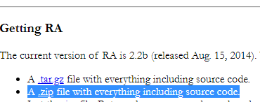
Installing Relational Algebra tool (RA)
Link to download Tool: https://users.cs.duke.edu/~junyang/ra2/
Download the .zip file from the above link:
Extract the zip file. You can keep this extracted folder anywhere.

Slide 9
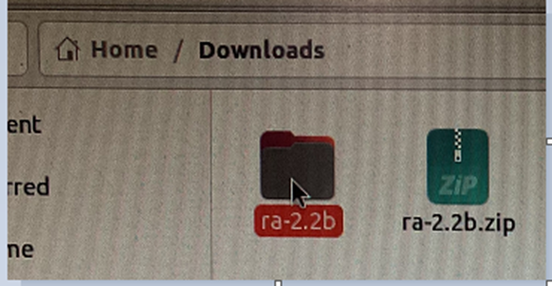
Installing Relational Algebra tool (RA) …Contd.
Extract the zip file. You can keep this extracted folder anywhere.

Slide 10
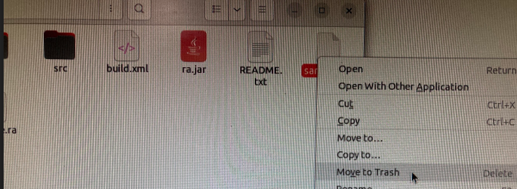
Setting up the RA tool
Recall that you have created a database using sqlite3, we have to link this to RA tool. Let us assume you have created a database using sqlite and is named firstdatabase.db
When you open the extracted RA tool folder, you will see file called ‘sample.db’. Delete this file.

Slide 11
Important slide about RA tool setup
We have to replace this file with our database file: First delete this ‘sample.db’ file that comes by default and paste the your database file (say firstdatabase.db). After pasting here rename it to sample.db.
☺ DB is set and RA is set ☺ , so simple!

Slide 12
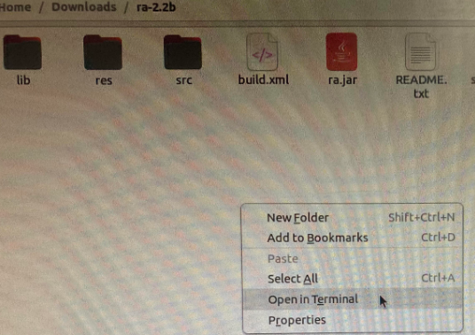
Running the RA tool
Go to the RA tool extracted folder, right click and open the terminal from there itself //to avoid changing the paths.

Slide 13
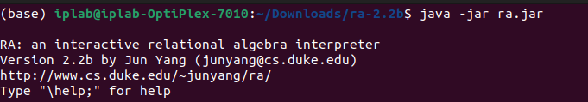
Running the RA tool …Contd.
Run this command on the terminal: java -jar ra.jar

Slide 14
Running RA queries
We have to issue RA commands to work. The commands are similar to normal Relational Algebra operators but in notes we write we write symbols here we write words. For example we write project as “pi symbol” but here it is “\project_{attribute list}. Similarly other too, for example crossproduct is written here as \cross. This will be clear with the coming slides.

Slide 15
Running RA queries …Contd.
Assume we have created the following tables during the sqlite databse creation.
firsttable: with attributes id,name
secondtable: with attributes id, name
thirdtable: with attributes id, name
fourthtable: with attributes id, occupation

Slide 16
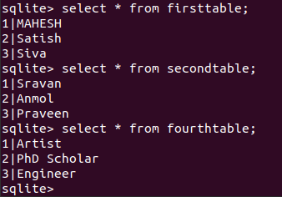
Running RA queries …Contd.
(These are the tables I created during sqlite database creation time)

Slide 17
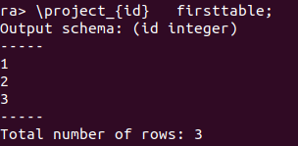
Running RA queries …Contd.
As mentioned in the previous slides we just have to write expression in the tool format. Let us see some examples so that it explains everything.
1. Projecting the ids of firsttable; //firsttable is a table;

Slide 18
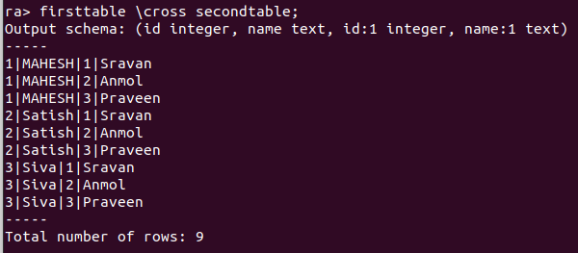
Running RA queries …Contd.
2. Let us see cross product- the syntax is: table1 \cross table2;

Slide 19
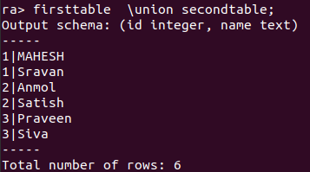
Running RA queries …Contd.
3. Union- the syntax is: table1 \union table2;

Slide 20
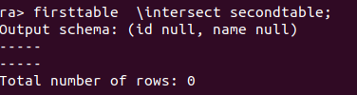
Running RA queries …Contd.
4. Intersection- The syntax is: table 1 \intersect table 2;

Slide 21
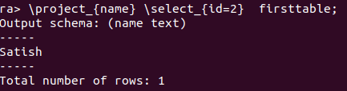
Running more complex queries
Applying condition:
Note that select is used for giving condition in Relational algebra.
The syntax is \select{condtion};
The below query selects names whose id is 2.

Slide 22
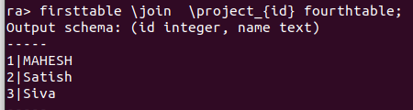
Running more complex queries …Contd.
2. Applying join on specific attribute:
3. Similarly we can write more complex queries ☺

Slide 23
Important notes on RA tool
Either start the terminal right clicking from the Extracted(extracted from the zip file downloaded) RA folder OR set path to this folder and then start running RA.
As explained previously, don’t forget to delete the sample.db that comes with RA tool and replace with your sqlite database and then rename to sample.db.

Slide 24
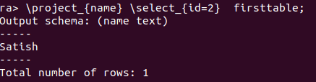
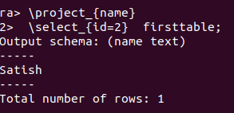
Important notes on RA tool …Contd.
3. You can give query either in single long line OR in two or more lines, that is, you can enter some portion of query and hit enter and then next portion of query and enter etc, please see below figures both give same output.

Slide 25
Official site of RA tool for reference
This RA tool is hosted at https://users.cs.duke.edu/~junyang/ra2/
You can find all the required information about installation and documentation about syntaxes etc here.

Slide 26
Conclusion
We have seen how to install sqlite3 and creating database with it.
We have seen how to install and work with RA tool.
It is observable that it is pretty easy to work with sqlite3 and RA tool.
If any doubts, you may write to mahesh_p200056cs@nitc.ac.in.

Slide 27
Acknowledgements
The source of the RA tool talked in this presentation is https://users.cs.duke.edu/~junyang/ra/ .

Slide 28
Thank you!

